Slide 1
Chapter 19

Slide 2
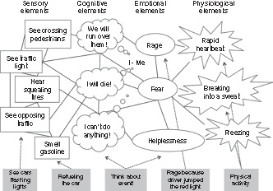
Figure 1 Schematic presentation of a hypothetical sensory-perceptual representation—a so-called fear network, including sensory, cognitive, emotional, and physiological elements. The network represents a casualty's memory of a car accident. The boxes indicate environmental stimuli with the potential to activate the representation.
Modified from Ref. 18.

